Slide 1
210252- ADVANCED DATA STRUCTURES
Advanced Data Structures
SE, Computer Engineering (2015 Pattern)
(50 Marks Online, 50 Marks offline)
Prof. C. S. Arya
Assistant Professor, Department of Computer Engineering
Jaihind College of Engineering, Kuran
(Affiliated to Savitribai Phule Pune University, Pune)

Slide 2
ADS and ADSL Teaching Scheme
210252-Advanced Data Structures
Teaching Scheme:
TH: 04 Hours/Week Credit -04
Examination Scheme:
In-Sem(online): 50 Marks
End-Sem(Paper): 50 Marks
210256-Advanced Data Structures Laboratory
Scheme:
PR: 04 Hours/Week Credit -02
Examination Scheme:
TW: 25 Marks
PR: 50 Marks

Slide 3
ADVANCED DATA STRUCTURES SYLLABUS
2
Syllabus: UNIT-I- Trees
Tree- basic terminology, General tree and its representation, representation using sequential and linked organization, Binary tree- properties, converting tree to binary tree.
binary tree traversals- inorder, preorder, post order, level wise -depth first and breadth first, Operations on binary tree.
Binary Search Tree (BST), BST operations,
Threaded binary tree- concepts, threading, insertion and deletion of nodes in in-order threaded binary tree, in order traversal of in-order threaded binary tree.
Case Study- Use of binary tree in expression tree-evaluation and Huffman's coding.

Slide 4
ADVANCED DATA STRUCTURES SYLLABUS
3
Syllabus: UNIT-II- Graphs
Basic Concepts, Storage representation, Adjacency matrix, adjacency list, adjacency multi list, inverse adjacency list. Traversals-depth first and breadth first, Introduction to Greedy Strategy, Minimum spanning Tree, Greedy algorithms for computing minimum spanning tree- Prims and Kruskal Algorithms, Dikjtra's Single source shortest path, Topological ordering.
Case study- Data structure used in Webgraph and Google map.

Slide 5
ADVANCED DATA STRUCTURES SYLLABUS
4
Syllabus: UNIT-III- Hashing
Hash Table- Concepts-hash table, hash function, bucket, collision, probe, synonym, overflow, open hashing, closed hashing, perfect hash function, load density, full table, load factor, rehashing, issues in hashing, hash functions- properties of good hash function, division, multiplication, extraction, mid-square, folding and universal, Collision resolution strategies- open addressing and chaining, Hash table overflow- open addressing and chaining, extendible hashing.
Dictionary- Dictionary as ADT, ordered dictionaries.
Skip List- representation, searching and operations- insertion, removal.

Slide 6
ADVANCED DATA STRUCTURES SYLLABUS
5
Syllabus: UNIT-IV- Search Trees
Symbol Table-Representation of Symbol Tables- Static tree table and Dynamic tree table, Introduction to Dynamic Programming, Weight balanced tree, Optimal Binary Search Tree (OBST), OBST as an example of Dynamic Programming, Height Balanced Tree- AVL tree.

Slide 7
ADVANCED DATA STRUCTURES SYLLABUS
6
Syllabus: UNIT-V- Indexing & Multiway Trees
Indexing and Multiway Trees- Indexing, indexing techniques, Types of search tree- Multiway search tree, B-Tree, B+Tree, Trie Tree, Splay Tree, Red-Black Tree, K-dimensional tree, AA tree.
Set- Set ADT, realization of Set and operations.
Heap-Basic concepts, realization of heap and operations, Heap as a priority queue, heap sort

Slide 8
ADVANCED DATA STRUCTURES SYLLABUS
2
Syllabus: UNIT-VI- File Organization
Sequential file organization- concept and primitive operations, Direct Access File- Concepts and Primitive operations,
Indexed sequential file organization-concept, types of indices, structure of index sequential file,
Linked Organization- multi list files, coral rings, inverted files and cellular partitions.
External Sort- Consequential processing and merging two lists, multiday merging- a k way merge algorithm.

Slide 9
UNIT–I Topics
3
Types of Data Structures
Examples for each type
Tree Data Structure
Basic Terminology
Tree ADT
Traversal Algorithms
Binary Trees
Binary Tree Representations
Binary Tree ADT
Binary Tree Traversals- Preorder, In-order, Post order Recursive and Non- Recursive
Operations on Binary Tree

Slide 10
UNIT-I Topics Continue…
2
Binary Search Tree
Representation
Operations on BST
BST Traversals
Performance
Threaded Binary Tree
Representation
Operations
Performance
Expression Tree and Huffman’s Coding

Slide 11
Recommended Books
Data Structures using C, Reema Thareja, Oxford University Press.
Data Structures using C++, Varsha Patil, Oxford University Press.
Schaum's Outline Series, Theory and problems of Data Structures by Seymour Lipschutz
Data Structures using C and C++,2nd edition by A.Tenenbaum, Augenstein, and Langsam
Principles Of Data Structures Using C And C++ by Vinu V Das Sams Teach Yourself Data Structures and Algorithms in 24 Hours, Lafore Robert
Data structures and algorithms, Alfred V. Aho, John E. Hopcroft.
Standish, Thomas A., Data Structures, Algorithms and Software Principles in C, Addison-Wesley 1995, ISBN: 0-201-59118-9
Data Structures & Algorithm Analysis in C++, Weiss Mark Allen

Slide 12


Good Programming Practices
No hard-coding
Program without warning
As much as possible, write optimized code

Slide 13
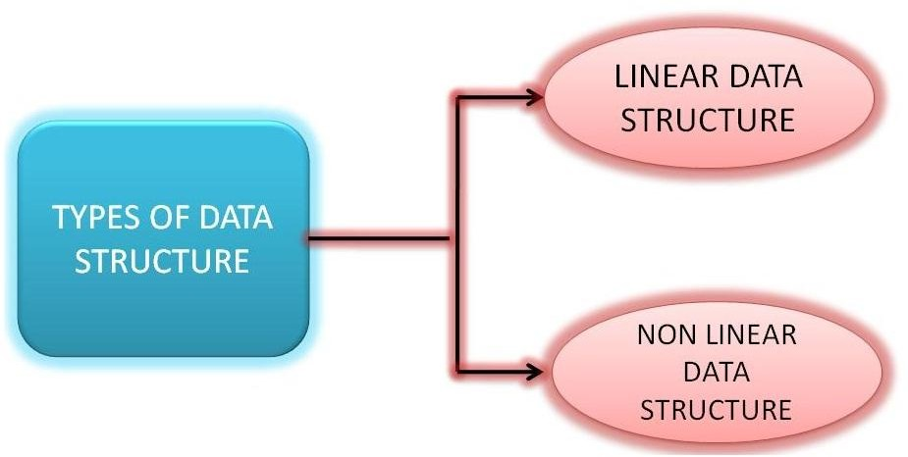
Types of Data Structure
4

Slide 14
Linear Data Structures
5
In linear data structure, member elements form a sequence. Such linear structures can be represented in memory by using one of the two basic strategies
By having the linear relationship between the elements represented by means of sequential memory locations. These linear structures are called arrays. By having relationship between the elements represented by pointers. These structures are called linked lists.

Slide 15
When to use them
6
Arrays are useful when number of elements to be stored is fixed.
Operations like traversal searching and sorting can easily be performed on arrays.
On the other hand, linked lists are useful when the number of data items in the collection are likely to change.

Slide 16
Nonlinear Data Structures
7
In nonlinear data structures, data elements are not organized in a sequential fashion. A data item in a nonlinear data structure could be attached to several other data elements to reflect a special relationship among them and all the data items cannot be traversed in a single run.
Data structures like multidimensional arrays, trees and graphs are some examples of widely used nonlinear data structures.

Slide 17
Examples
8
A Multidimensional Array is simply a collection of one- dimensional arrays.
A Tree is a data structure that is made up of a set of linked nodes, which can be used to represent a hierarchical relationship among data elements.
A Graph is a data structure that is made up of a finite set of edges and vertices. Edges represent connections or relationships among vertices that stores data elements.

Slide 18
Difference
9
Main difference between linear and nonlinear data structures lie in the way they organize data elements.
In linear data structures, data elements are organized sequentially and therefore they are easy to implement in the computer’s memory.
In nonlinear data structures, a data element can be attached to several other data elements to represent specific relationships that exist among them.

Slide 19
Difficult to Implement
10
Due to this nonlinear structure, they might be difficult to implement in computer’s linear memory compared to implementing linear data structures.
Selecting one data structure type over the other should be done carefully by considering the relationship among the data elements that needs to be stored.

Slide 20
A Specific Example
11
Imagine you are hired by a company XYZ to:
organize all of their records into a computer database.
The first thing you are asked to do is create a database of names with all the company's management and employees.
To start your work, you make a list of everyone in the company along with their position and other details.

Slide 21
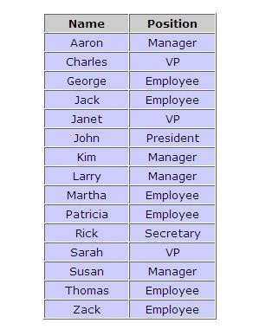
Employees Table
12

Slide 22
Disadvantages of Tables
13
But this list only shows one view of the company. You also want your database to represent the relationships between management and employees at XYZ.
Although your list contains both name and position, it does not tell you which managers are responsible for which workers and so on.
After thinking about the problem for a while, you decide that a tree diagram is a much better structure for showing the work relationships at XYZ.

Slide 23
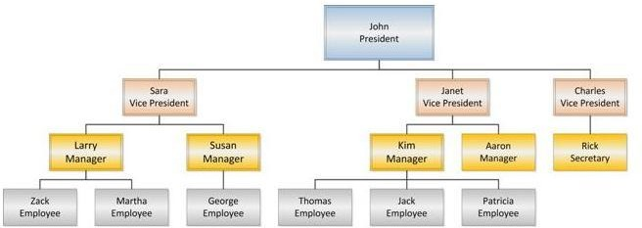
Better Representation
14

Slide 24
Comparison
15
These two diagrams are examples of different data structures.
In one of the data structures, your data is organized into a list. This is very useful for keeping the names of the employees in alphabetical order so that we can locate the employee's record very quickly.
However, this structure is not very useful for showing the relationships between employees. A tree structure is much better suited for this purpose.

Slide 25
Tree Data Structure
16
A Tree is a nonlinear data structure that models a hierarchical organization.
The characteristic features are that each element may have several successors (called its “children”) and every element except one (called the “root”) has a unique predecessor (called its “parent”).
Trees are common in computer science: Computer file systems are trees, the inheritance structure for C++/Java classes is a tree.

Slide 26
What is a Tree ?
17
A tree is a nonlinear data structure, compared to arrays, linked lists, stacks and queues which are linear data structures. A tree can be empty with no nodes or a tree is a structure consisting of one node called the root and zero or one or more sub trees.
A tree consists of nodes relation with a parent-child
Applications:
Organization Charts
File Systems
Programming Environment

Slide 27
Tree Definition
18
Here is the recursive definition of an (unordered) tree:
A tree is a pair (r, S), where r is a node and S is a set of disjoint trees, none of which contains r.
The node r is called the root of the tree T, and the elements of the set S are called its subtrees.
The set S, of course, may be empty.
The elements of a tree are called its nodes.

Slide 28
Root, Parent and Children
19
If T = (x, S) is a tree, then
x is the root of T and
S is its set of subtrees S = {T1, T2, T3, . . ., Tn}.
Each subtree Tj is itself a tree with its own root rj .
In this case, we call the node r the parent of each node
rj, and we call the rj the children of r. In general.

Slide 29
Basic Terminology
20
A node with no children is called a leaf. A node with at least one child is called an internal node.
The Node having further sub-branches is called
parent node.
Every node c other than the root is connected by an edge to some one other node p called the parent of c.
We also call c a child of p.

Slide 30
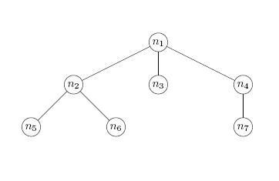
An Example
n1 is the parent of n2 ,n3 and n4, while n2 is the parent of n5 and n6. Said another way, n2, n3, and n4 are children of n1, while n5 and n6 are children of n2.

Slide 31
Connected Tree
22
A tree is connected in the sense that if we start at any node n other than the root, move to the parent of n, to the parent of the parent of n, and so on, we eventually reach the root of the tree.
For instance, starting at n7, we move to its parent, n4, and from there to n4’s parent, which is the root, n1.

Slide 32
Ancestors and Descendants
23
The parent-child relationship can be extended naturally to ancestors and descendants.
Informally, the ancestors of a node are found by following the unique path from the node to its parent, to its parent’s parent, and so on.
The descendant relationship is the inverse of the ancestor relationship, just as the parent and child relationships are inverses of each other.

Slide 33
Path and Path Length
More formally, suppose m1,m2, . . . ,mk is a sequence of nodes in a tree such that m1 is the parent of m2, which is the parent of m3, and so on, down to mk−1, which is the parent of mk. Then m1,m2, . . . ,mk is called a path from m1 to mk in the tree. The path length or length of the path is k −1, one less than the number of nodes on the path.

Slide 34
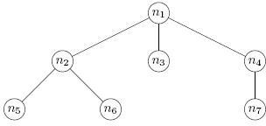
In our Example
25
n1, n2, n6 is a path of length 2 from the root n1 to the node n6.

Slide 35
Height and Depth
26
In a tree, the height of a node n is the length of a longest path from n to a leaf. The height of the tree is the height of the root.
The depth, or level, of a node n is the length of the path from the root to n.

Slide 36
In our Example
27
node n1 has height 2, n2 has height 1, and leaf n3 has height 0. In fact, any leaf has height 0. The height of the tree is 2. The depth of n1 is 0, the depth of n2 is 1, and the depth of n5 is 2.

Slide 37
Other Terms
28
The size of a tree is the number of nodes it contains.
The total number of subtrees attached to that node is called the degree of the node.
Degree of the Tree is nothing but the maximum degree in the tree.
The nodes with common parent are called siblings or brothers.

Slide 38
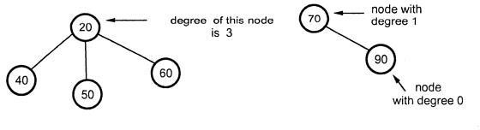
Degree
29

Slide 39
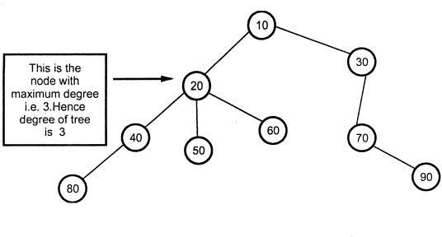
Degree of the Tree
30

Slide 40
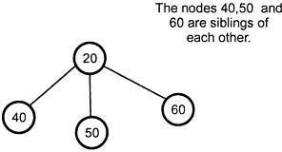
Siblings
31

Slide 41
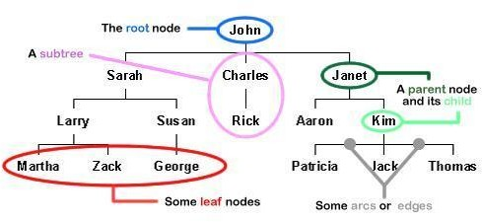
Terminology Explained
32

Slide 42
Types of Tree
General trees
Binary trees
Binary search trees
Expression trees
Tournament trees
Complete tree
Strictly Binary Tree
Extended Binary Tree
Skewed Binary Tree
Decision Tree
Position tree

Slide 43
General Tree
A tree T is defined recursively as follows:
A set of zero items is a tree, called the empty tree (or null tree).
If T1, T2, ..., Tn are n trees for n > 0 and R is a node, then the set T containing R and the trees T1, T2, ..., Tn are a tree. Within T, R is called the root of T, and T1, T2, ..., Tn are called subtrees.

Slide 44
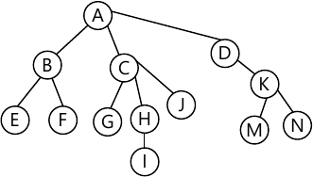
In an Example

Slide 45
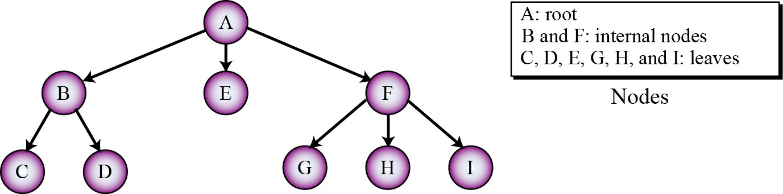
Another Example
33

Slide 46
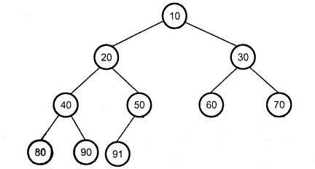
Complete Binary Tree
n
A complete binary tree is a binary tree that satisfies two properties. First, in a complete binary tree, every level, except possibly the last, is completely filled. Second, all nodes appear as far left as possible.
In a complete binary tree T , there are exactly n nodes and level r of T can have at most 2r nodes.

Slide 47
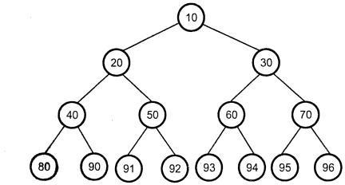
Full Binary Tree
In a full binary tree, each node has two children or no child at all. The total number of nodes in a full binary tree of height h is 2h+1 - 1 considering the root at level 0.
A binary tree is a full binary tree if it contains the maximum possible number of nodes in all levels.

Slide 48
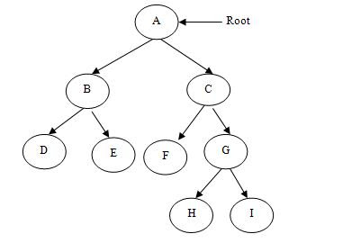
Strictly Binary Tree
If every non-terminal node in a binary tree consists of non-empty left and right sub- trees, then such a tree is called a strictly binary tree.

Slide 49
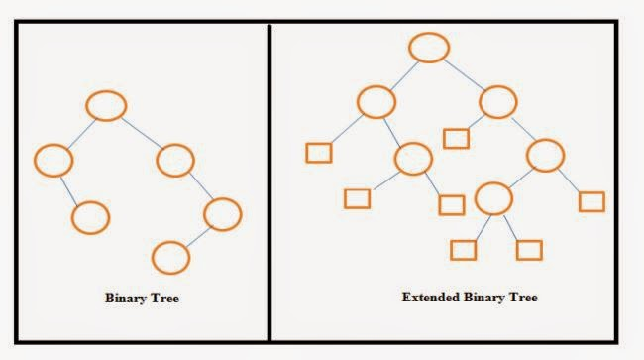
Extended Binary Tree
A binary tree T with each node having zero or two children is called an extended binary tree. The nodes with two children are called internal nodes, and those with zero children are called external nodes. Trees can be converted into extended trees by adding a node

Slide 50
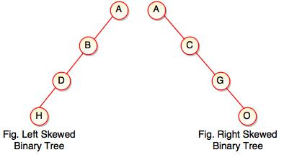
Skewed Binary Tree
Left skewed binary tree:
If the right subtree is missing in every node of a tree, we call it a left skewed tree.
Right skewed binary tree:
If the left subtree is missing in every node of a tree, we call it as right subtree.

Slide 51
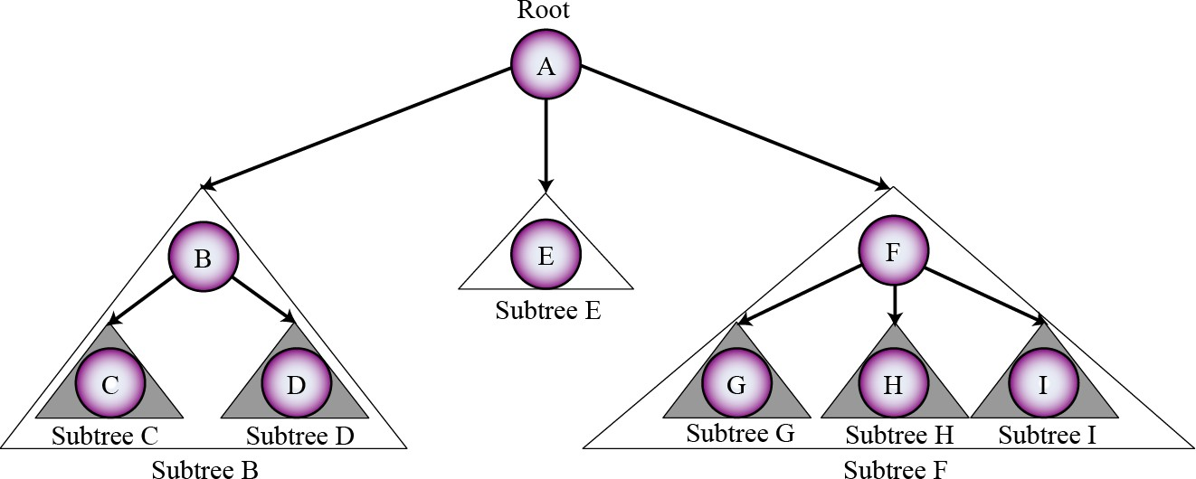
Subtrees
34

Slide 52
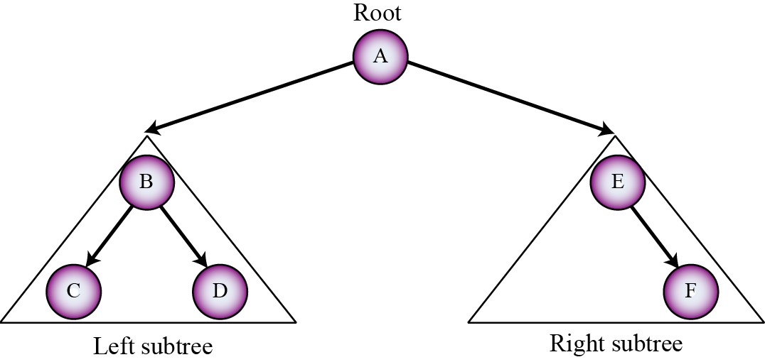
Binary Trees
35
A binary tree is a tree in which no node can have more than two subtrees. In other words, a node can have zero, one or two subtrees.

Slide 53
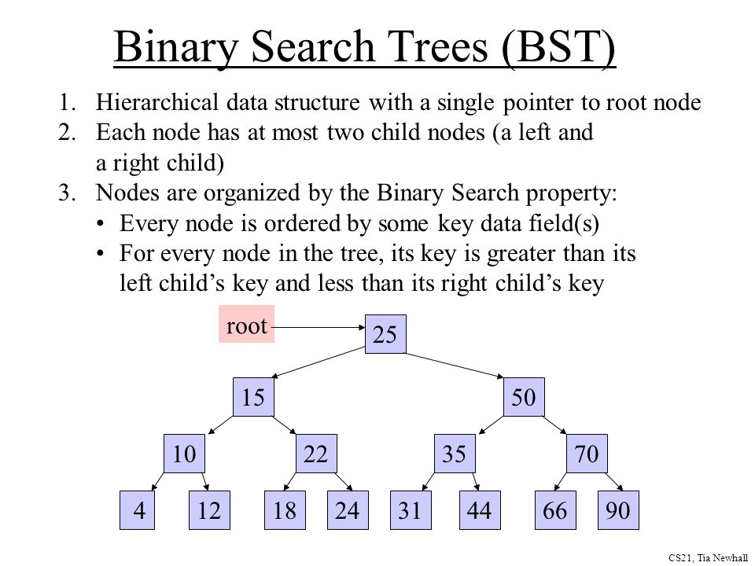
Binary Search Trees

Slide 54
Tree and Binary Tree Difference
It is important to understand that while binary trees require us to distinguish whether a child is either a left child or a right child, ordinary trees require no such distinction.
There is another technical difference. While trees are defined to have at least one node, it is convenient to include the empty tree, the tree Empty tree with no nodes, among the binary trees.

Slide 55

Tree Difference Contd…
That is, binary trees are not just trees all of whose nodes have two or fewer children.
Not only are the two trees in the above Figure are different from each other, but they have no relation to the ordinary tree consisting of a root and a single child of the root:

Slide 56
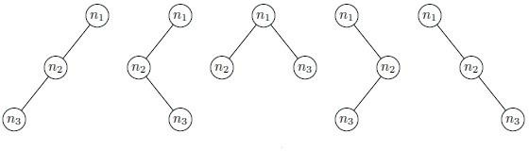
Five Binary Trees with 3 nodes

Slide 57
Binary Tree ADT
36
The tree ADT stores elements at positions, which are defined relative to neighboring positions.
Positions in a tree are its nodes, and the neighboring positions satisfy the parent-child relationships that define a valid tree.
Tree nodes may store arbitrary objects.

Slide 58
Binary Tree ADT Contd…

Slide 59
Representation of Binary Tree
If a complete binary tree with n nodes (depth = log n+ 1) is represented sequentially, then for any node with index i, 1 ≤ i ≤ n, we have:
parent(i) is at i/2 if i!=1. If i=1, i is at the root and has no parent.
leftChild (i) is at 2i if 2i ≤ n. If 2i > n, then i has no left child.
Right Child (i) is at 2i+1 if 2i +1 ≤ n. If 2i+1>n, then i has no right child.

Slide 60
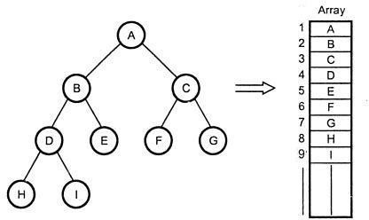
Representation of Binary Tree
Sequential Representation

Slide 61
Array Implementation
Advantages
Direct Access
Finding the Parent / Children is fast
Disadvantages
Wastage of memory
Insertion and Deletion will be costlier
Array size and depth

Slide 62
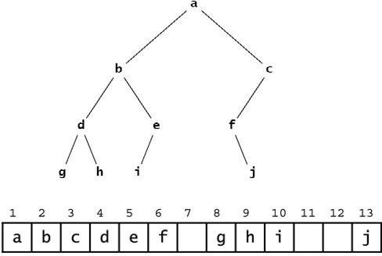
Disadvantages of Array Implementation
Figure above shows the incomplete binary tree and the natural mapping of its nodes into an array which leaves some gaps.

Slide 63
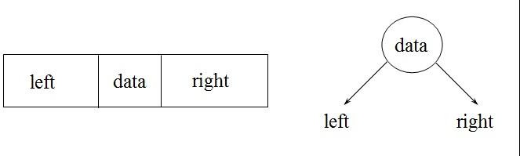
Representation of Binary Tree
Linked Representation
typedef struct tnode
{
int data;
ttnode *left, *right;
};

Slide 64
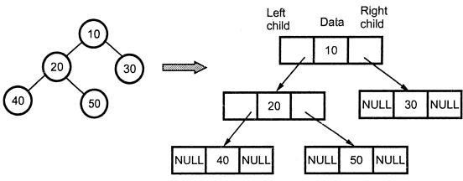
Linked Implementation

Slide 65
Linked Implementation
Advantages
No wastage of memory
Insertion and Deletion will be easy
Disadvantages
Does not provide direct access
Additional space in each node.

Slide 66
Properties of Binary Trees

Slide 67
Binary Tree Operations
Basic Operations:
Creating a Binary Tree
Binary Tree Traversals
Insertion operation
Deletion Operation
Auxiliary Operations:
Counting Nodes
Counting Leaf Nodes
Computing Height of BT
Copying Binary Tree
Equality Test
Creating Replica of BT or Mirror

Slide 68
Binary Tree Operations
Binary Tree Creation:
This Function Create an empty binary tree to which the ‘root’ points.
class TreeNode
{
public:
char data;
TreeNode *Lchild;
TreeNode *Rchild;
};
class BinaryTree
{
private:
TreeNode *root;
public:
BinaryTree() //constructor create an empty tree
{
root=NULL;
};

Slide 69
Binary TreeTraversals
44
Traversal is a frequently used operation. Traversal of a tree means stepping through the nodes of a tree by means of the connections between parents and children, which is also called walking the tree, and the action is a walk of the tree. Traversal means visiting every
node of a binary tree.
A traversal (circumnavigation) algorithm is a method for processing a data structure that applies a given operation to each element of the structure.
For example, if the operation is to print the contents of the element, then the traversal would print every element in the structure.
The process of applying the operation to an element is called visiting the element. So executing the traversal algorithm causes each element in the structure to be visited.

Slide 70
BT Traversal Algorithms
There are various traversal methods. For a systematic traversal, it is better to visit each node (starting from the root) and its two subtrees in the same way. In other words, when traversing, we need to treat each node and its subtree in the same fashion. If we let L, Root, and R stand for moving left, Root, and moving right, respectively.
when at a node, then there are six possible combinations—
Left Root Right→Inorder
Left Right Root →Postorder
Root Left Right→ Preorder
RootRL
RRootL, and
RLRoot.

Slide 71
Recursive Tree Traversal
Inorder Tree Traversal (also called as symmetric traversal)
In this traversal, the left subtree is visited first in inorder followed by the root and then the right subtree in inorder. This can be defined as the following:
Inorder (Left Root Right) Algorithm
1. Traverse the left subtree of the root node in inorder.
2. Visit the root node node.
3. Traverse the right subtree of the root node in inorder.
Code:
void BinaryTree :: Inorder(TreeNode*) {
if(Root != Null)
{
Inorder(Root->Lchild);
cout << Root->Data;
Inorder(Root->Rchild);
}
}

Slide 72
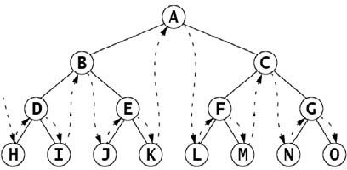
In our Example
Figure above shows the inorder sequence- HDIBJEKALFMCNGO

Slide 73
Recursive Tree Traversal
Preorder Tree Traversal (also called as depth-first traversal)
In this traversal, the root is visited first followed by the left subtree in preorder and then the right subtree in preorder. This can be defined as the following:
Preorder (Root Left Right) Algorithm
1.Visit the root node.
2.Traverse the left subtree of the node in preorder.
3.Traverse the right subtree of the node in preorder.
Code:
void BinaryTree :: Preorder(TreeNode*) {
if(Root != Null)
{
cout << Root->Data;
Preorder(Root->Lchild);
Preorder(Root->Rchild);
}
}

Slide 74
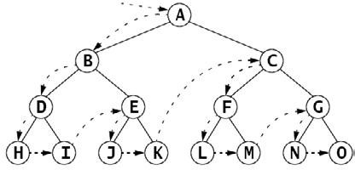
In our Example
Figure above shows the preorder sequence- ABDHIEJKCFLMGNO

Slide 75
Recursive Tree Traversal
Postorder Tree Traversal
In this traversal, the left subtree is visited first in postorder followed by the right subtree in postorder and then the root. This is defined as the following:
Postorder (Left Right Root) Algorithm
1.Traverse the left subtree of the node in postorder.
2.Traverse the right subtree of the node in postorder.
3.Visit the root node.
Code:
void BinaryTree :: Postorder(TreeNode*) {
if(Root != Null)
{
Postorder(Root->Lchild);
Postorder(Root->Rchild);
cout << Root->Data;
}
}

Slide 76
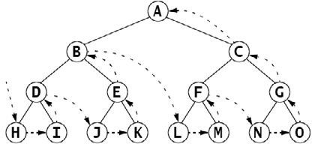
In our Example
Figure above shows the postorder sequence- HIDJKEBLMFNOGCA

Slide 77
Non Recursive BT Traversal
Knowledge of tree traversals is very important in order to completely understand Binary Trees. Though the recursive implementation of tree traversals can be coded very neatly but recursion is generally not preferred. Excessive recursive function calls may cause memory to run out of stack space.
Since the depth of a balanced binary search tree is about log(n), we need not worry about running out of stack space, even if there are a million elements in the tree.
Understanding the below given iterative traversals can be a little tricky so the best way to understand them is to work them out on a piece of paper.

Slide 78
Non Recursive Inorder BT Traversal
In Order Traversal:
The in order traversal requires that we print the leftmost node first and the right most node at the end. So basically for each node we need to go as far as down and left as possible and then we need to come back and go right.
Steps of algorithm are:
> 1. Start with the node equals root
> 2. Store the node in the stack and visit it's left child.
> 3. Repeat step 2 while node is not NULL, if it's NULL then pop it's parent (i.e. the last node in stack) and print it.
> 4. Now move to node's right child and repeat step 1
> 5. Repeat whole procedure while node is not NULL and stack is not empty

Slide 79
Inorder Non recursive Implementation
Inorder(Tree *p)
{
stack &lt; Tree* &gt; S;
do
{
while (p!=NULL)
{
// store a node in the stack and visit it's left child
S.push(p);
p=p-&gt;left;
}
// If there are nodes in the stack to which we can move up
// then pop it
if (!S.empty())
{
p=S.top();
S.pop();
// print the nodes value
cout &lt;&lt; p-&gt;ele &lt;&lt; "-";
// vistit the right child now
p=p-&gt;right;
}
// while the stack is not empty or there is a valid node
}while(!S.empty()||p!=NULL);
}

Slide 80
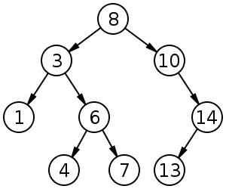
In our Example
Use this sample binary tree and follow the steps of the below given codes.

Slide 81
Non Recursive Tree Traversal
Preorder Traversal
Pre order is very similar to in order traversal. The way of accessing all the nodes remains the same except the position where we print the node. Now the node is printed/visited before visiting the children of the nodes.
Steps of algorithms are:
> 1. Start with node equal to root node
> 2. Store the node in the stack, print it and visit it's left child.
> 3. Repeat step 2 while node is not NULL, if it's NULL then pop it's parent (i.e. the last node in stack).
> 4. Now move to node's right child and repeat step 2
> 5. Repeat whole procedure while node is not NULL and stack is not empty

Slide 82
Preorder Non recursive Implementation
Preorder(Tree *p)
{
stack &lt; Tree* &gt; S;
do
{
while (p!=NULL)
{
// storea node in stack and print it's value
S.push(p);
cout &lt;&lt; p-&gt;ele &lt;&lt; "-";
// visit the left child
p = p-&gt;left;
}
// visit the right child
if (!S.empty())
{
p=S.top();
S.pop();
p = p-&gt;right;
}
} while(!S.empty()||p!=NULL);
}

Slide 83
In our Example
Use this sample binary tree and follow the steps of the below given codes.

Slide 84
Non Recursive Tree Traversal
Post Order Traversal:
Post order traversal is the trickiest one, out of all the three traversals. However post order traversal is important to understand because of the following 2 use cases
> * Tree deletion: In order to free up allocated memory of all nodes in a tree, the nodes must be deleted in the order where the current node is deleted when both of its left and right sub-trees are deleted. This can be done using post-order traversal only.
* It is also used in evaluating Post-fix or Reverse Polish Notation.
The problem with post-order traversal is that in the previous two cases when a node was popped of from the stack, then it was finally removed and was not accessed again. However in case of post-order the node needs to be accessed from the stack twice, and is deleted only in the second access.
First time we find a node, we push it on to the stack, the second time we examine it from the stack to go to it's right child and then finally after visiting both the right sub-tree and the left-subtree we remove the node from the stack. So a node stays in the stack as long as it's sub-trees have not been visited.

Slide 85
Non Recursive Postorder Traversal
Hence in this traversal, we have to use a previous pointer, only then will we able to correctly traverse the node. Otherwise we do not know when the right child has been visited or not.
Steps of algorithms are:
> 1. Start with the root node.
> 2. Store the node in the stack, and visit it's left child.
> 3. Repeat step 1 while node is not NULL, if it's NULL:
> * Pick the top most node from the stack.
> * If it's right child is NULL, then print the node and set prev pointer to this node
> * If it's not NULL, check whether the right child is equal to prev pointer, if it is then print the node, else repeat step 1 with the right child
> * In this step, if you print the node then current is made equal to NULL and this sub-loop is repeated until stack is not empty and current is NULL
> 4. Since the root node remains in the stack till the end, the terminating condition is until stack is empty

Slide 86
Implementation of Postorder Non Recursive Traversal
Postorder(Tree *p)
{
stack &lt; Tree* &gt; S;
Tree *prev = NULL;
do
{
while (p!=NULL)
{
S.push(p);
p = p-&gt;left;
}
while(p == NULL &amp;&amp; !S.empty())
{
p = S.top();
if(p-&gt;right == NULL || p-&gt;right == prev)
{
cout &lt;&lt; p-&gt;ele &lt;&lt; "-";
S.pop();
prev = p;
p = NULL;
}
else
p = p-&gt;right;
}
}while(!S.empty());
}

Slide 87
In our Example
Use this sample binary tree and follow the steps of the below given codes.

Slide 88
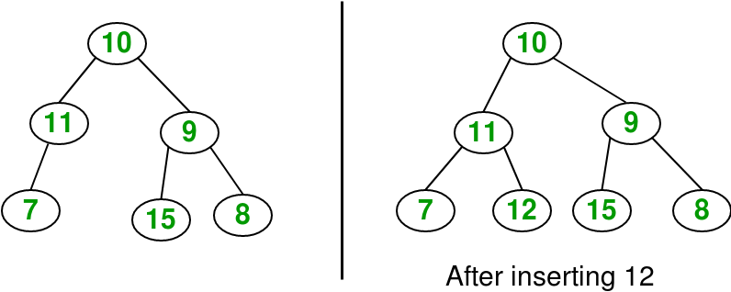
Insertion Operation- Binary Tree
Insertion operation in a binary tree can be done as:
Parent= (i-1)/2
Lchild= 2*i+1
Rchild= 2*i+2

Slide 89
Counting Nodes
CountNode() is the function that returns the total count of nodes in a linked binary tree.
int BinaryTree :: CountNode(TreeNode *Root)
{
if(Root == Null)
return 0;
else
return(1 + CountNode(Root->Rchild) + CountNode(Root->Lchild));
}

Slide 90
Counting Leaf Nodes
The CountLeaf() operation counts the total number of leaf nodes in a linked binary tree.
Leaf nodes are those with no left or right children.
int BinaryTree :: CountLeaf(TreeNode *Root)
{
if(Root == Null)
return 0;
else if((Root->Rchild == Null) && (Root->Lchild == Null))
return(1);
else
return(CountLeaf(Root->Lchild) + CountLeaf(Root->Rchild));
}

Slide 91
Computing Height of BT
The TreeHeight() operation computes the height of a linked binary tree. Height of a tree is the maximum path length in the tree. We can get the path length by traversing the tree depthwise. Let us consider that an empty tree’s height is 0 and the tree with only one node has the height 1.
int BinaryTree :: TreeHeight(TreeNode *Root)
{
int heightL, heightR;
if(Root == Null)
return 0;
if(Root->Lchild == Null && Root->Rchild == Null)
return 0;
heightL = TreeHeight(Root->Lchild);
heightR = TreeHeight(Root->Rchild);
if(heightR > heightL)
return(heightR + 1);
return(heightL + 1);
}

Slide 92
Copying Binary Tree
The TreeCopy() operation makes a copy of the linked binary tree. The function should allocate the necessary nodes and copy the respective contents into them.
TreeNode *BinaryTree :: TreeCopy()
{
TreeNode *Tmp; if(Root == Null)
return Null;
Tmp = new TreeNode;
Tmp->Lchild = TreeCopy(Root->Lchild);
Tmp->Rchild = TreeCopy(Root->Rchild);
Tmp->Data = Root->Data;
return Tmp;
}

Slide 93
BT Equality Test
The BTree_Equal() operation checks whether two binary trees are equal. Two trees are said to be equal if they have the same topology, and all the corresponding nodes are equal. The same topology refers to the fact that each branch in the first tree corresponds to a branch in the second tree in the same order and vice versa.
int BinaryTree :: BTree_Equal(Binarytree T1 , BinaryTree T2)
{
if(Root == Null && T2.Root == Null)
return 1;
return(Root && T2.Root);
&&(Root->Data == T2.Root->Data);
&&BTree_Equal(Root->Lchild ,T2.Root->Lchild);
&&BTree_Equal(Root->Rchild, T2.Root->Rchild));
}

Slide 94
Replica or Mirror of BT
The Mirror() operation finds the mirror of the tree that will interchange all left and right subtrees in a linked binary tree.
void BinaryTree :: Mirror(TreeNode *Root)
{
TreeNode *Tmp; if(Root != Null)
{
Tmp = Root->Lchild;
Root->Lchild = Root->Rchild;
Root->Rchild = Tmp;
Mirror(Root->Lchild);
Mirror(Root->Rchild);
}
}

Slide 95
Level Order Traversal
45
The level order traversal algorithm visits the root, then visits each element on the first level, then visits each element on the second level, and so forth, each time visiting all the elements on one level before going down to the next level.
If the tree is drawn in the usual manner with its root at the top and leaves near the bottom, then the level order pattern is the same left-to-right top-to- bottom pattern that you follow to read English text.

Slide 96
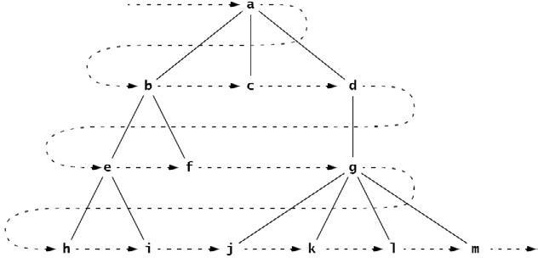
Level Order Example
46

Slide 97
Level order Traversal - Algorithm
47
To traverse a non empty ordered tree:
Initialize a queue.
Enqueue the root.
Repeat steps 4–6 until the queue is empty.
Dequeue node x from the queue.
Visit x.
Enqueue all the children of x in order.

Slide 98
In Our Example
48

Slide 99
Applications of Binary Trees
113
A Simple application of trees is to store mathematical expressions in a convenient form. Let's stick for the moment to expressions made up of numbers and the operators +, -, *, and /.
We will refer to a tree of this type as an Expression Tree

Slide 100
Algebraic Expressions - Introduction
114
An algebraic expression is a legal combination of operands and operators. Operand is the quantity (unit of data) on which a mathematical operation is performed.
Operand may be a variable like x, y, z or a constant like 5, 4,0,9,1 etc. Operator is a symbol which signifies a mathematical or logical operation between the operands.
We can write an example of expression as x+y*z.

Slide 101
Algebraic Expressions
115
Note the phrase "LEGAL combination" in the definition of an Algebraic Expression, in aforementioned example of expression x+y*z, the operands x , y, z and the operators +,* form some legal combination.
Take another example +xyz*, in this expression operators and operands do not make any LEGAL combination; this expression is not a valid algebraic expression.

Slide 102
Algebraic Expressions (2)
116
An Algebraic Expression can be represented using three different notations:
INFIX: From our school times we have been familiar with the expressions in which operands surround the operator, e.g. x+y, 6*3 etc this way of writing the Expressions is called infix notation.
PREFIX: Prefix notation also Known as Polish notation, is a symbolic logic invented by Polish mathematician in 1920's. In the prefix notation, as the name only suggests, operator comes before the operands, e.g. +xy, *+xyz etc.
POSTFIX: Postfix notation is also Known as Reverse Polish notation. They are different from the infix and prefix notations in the sense that in the postfix notation, the operator comes after the operands, e.g. xy+, xyz+* etc.

Slide 103
Algebraic Expressions (3)
117
Now, | the | obvious question that | comes in our mind is,
Why | use | these weird looking | PREFIX and POSTFIX
notations when we have a sweet and simple INFIX notation?
To our surprise INFIX notations are not as simple as they seem specially while evaluating them. To evaluate an infix expression we need to consider Operators' Priority and Associativity.

Slide 104
Algebraic Expressions (3)
118
Due to the above mentioned problem of considering operators' Priority and Associativity while evaluating an expression using infix notation, we use prefix and postfix notations.
Both prefix and postfix notations have an advantage over infix that while evaluating an expression in prefix or postfix form we need not consider the Priority and Associativity of the operators. Both prefix and postfix notations make Expression Evaluation a lot easier.

Slide 105
How to Represent ?
119
Arithmetic expressions can be represented by labeled trees, and it is often quite helpful to visualize expressions as trees.
In fact, expression trees, as they are sometimes called, specify the association of an expression’s operands and its operators in a uniform way, regardless of whether the association is required by the placement of parentheses in the expression or by the precedence and associativity rules for the operators involved.

Slide 106
General Idea
120
The general idea is that each time we form a larger
expression | by | applying | an | operator to | smaller
expressions, | we | create a | new | node, labeled | by that
operator.
The new node becomes the root of the tree for the large expression, and its children are the roots of the trees for the smaller expressions.

Slide 107
The Rule
121
For instance, we
can define the labeled trees for
arithmetic expressions with the binary operators:
BASIS. A single atomic operand (e.g., a variable, an integer, or a real) is an expression, and its tree is a single node, labeled by that operand.
INDUCTION. If E1 and E2 are expressions represented by trees T1 and T2, respectively, then the expression (E1 + E2) is represented by the tree of whose root is labeled +. This root has two children, which are the roots of T1 and T2, respectively, in that order.

Slide 108
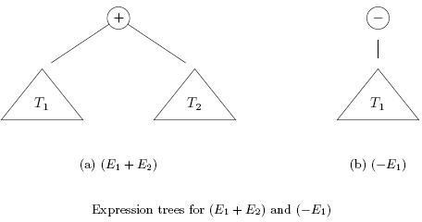
Apply the Rule
122

Slide 109
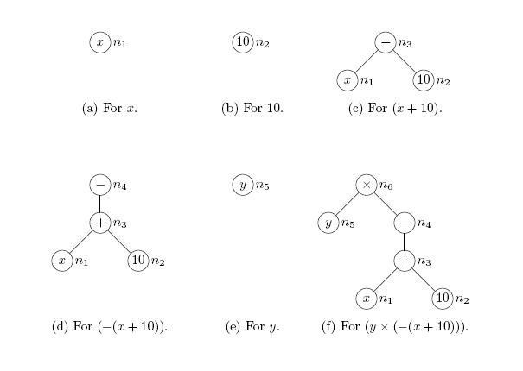
Examples
123

Slide 110
Expression Tree
124
Consider the expression 2*3/(2-1)+5*(4-1). This expression is made up of two subexpressions, 2*3/(2-
and 5*(4-1), combined with the operator "+".
When the expression is represented as a binary tree, the root node holds the operator +, while the subtrees of the root node represent the subexpressions 2*3/(2- 1) and 5*(4-1).

Slide 111
Expression Tree (2)
125
Every node in the tree holds either a number or an operator. A node that holds a number is a leaf node of the tree.
A node that holds an operator has
two subtrees the operator
representing the operands to which
applies. The tree is shown in the next Slide.

Slide 112
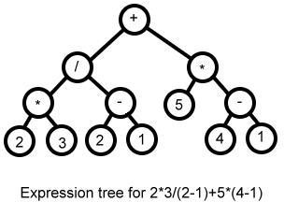
Expression Tree (3)
126

Slide 113
Expression Tree - Evaluation
127
Given an expression tree, it's easy to find the value of the expression that it represents. Each node in the tree has an associated value.
If the node is a leaf node, then its value is simply the number that the node contains. If the node contains an operator, then the associated value is

Slide 114
Expression Tree – Evaluation (2)
128
The process is shown by the upward-directed arrows in the illustration. The value computed for the root node is the value of the expression as a whole. There are other uses for expression trees. For example, a postorder traversal of the tree will output the postfix form of the expression.

Slide 115
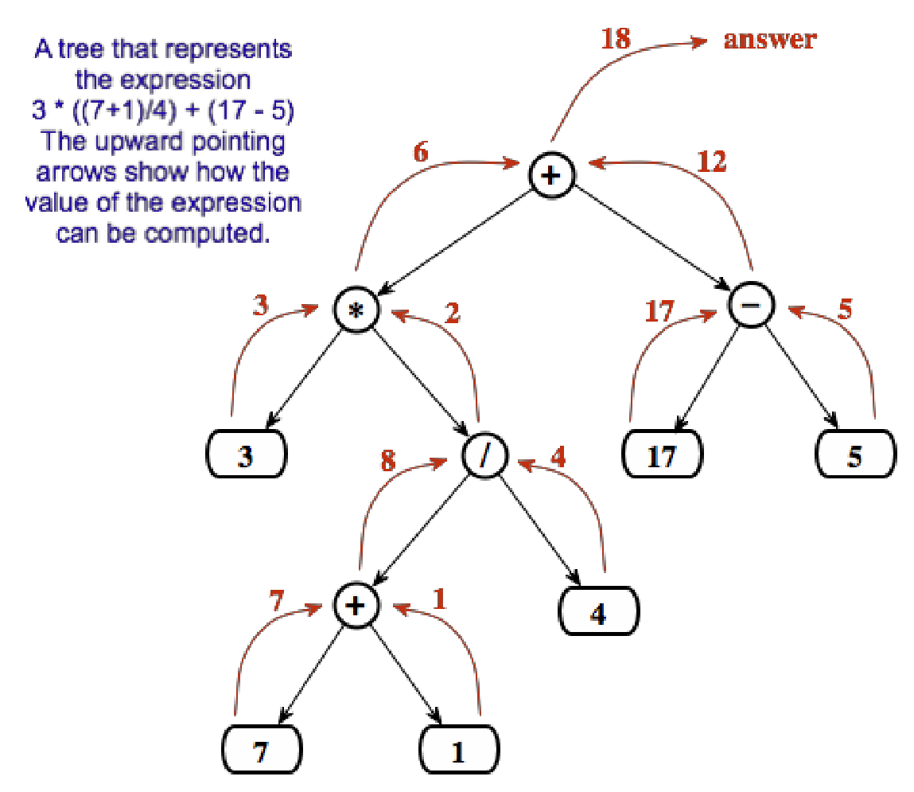
Expression Tree - Evaluation (3)
129

Slide 116
Binary Search Trees
130
Search trees are data structures that support many dynamic-set operations, including SEARCH, MINIMUM, MAXIMUM, PREDECESSOR, SUCCESSOR, INSERT, and DELETE.
Thus, a search tree can be used both as a dictionary and as a priority queue.
One good way to implement a dictionary is with a binary search tree, which is a kind of labeled binary tree.

Slide 117
Binary Search Tree Property
131
A binary search tree (BST) is a labeled binary tree in which the following property holds at every node x in the tree:
All nodes in the left subtree of x have labels less than the label of x, and all nodes in the right subtree have labels greater than the label of x. This property is called the binary search tree property.

Slide 118
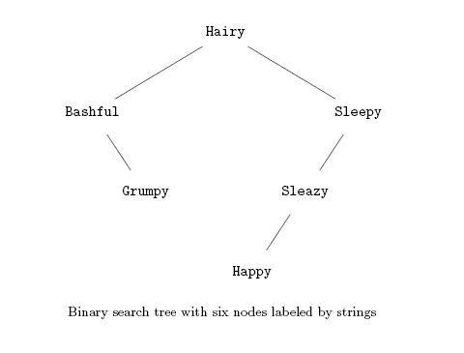
An Example
132

Slide 119
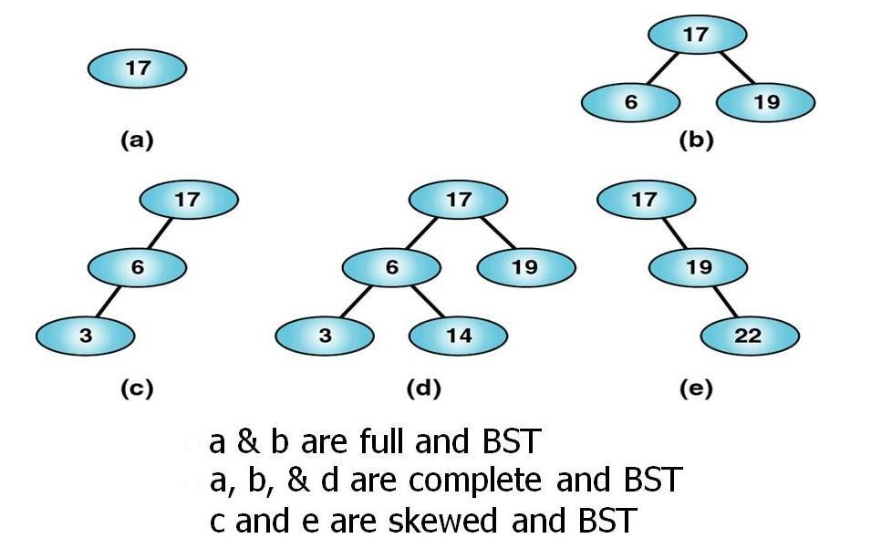
Some More Examples
133

Slide 120
Looking Up an Element
134
Suppose we want to look for an element x that may be in a dictionary represented by a binary search tree T . If we compare x with the element at the root of T , we can take advantage of the BST property to locate x quickly or determine that x is not present.
If x is at the root, we are done. Otherwise, if x is less than the element at the root, x could be found only in the left subtree (by the BST property); and if x is greater, then it could be only in the right subtree (again, because of the BST property).

Slide 121
A Recursive Algorithm
135
We can express the lookup operation by the following recursive algorithm.
BASIS. If the tree T is empty, then x is not present. If T is not empty, and x appears at the root, then x is present.
INDUCTION. If T is not empty but x is not at the root, let y be the element at the root of T . If x < y look up x only in the left subtree of the root, and if x > y look up x only in the right subtree of y. The BST property guarantees that x cannot be in the subtree we do not search.

Slide 122
Recursive Procedure
136
TREE-SEARCH(x, k)
if x = NIL or k = key[x]
then return x
if k < key[x]
4
5
then return TREE-SEARCH(left[x], k) else return TREE-SEARCH(right[x], k)

Slide 123
Iterative Procedure
137
The same procedure can be written iteratively by
“unrolling” the recursion with while loop. [Efficient on most computers]
ITERATIVE-TREE-SEARCH(x, k)
1 while x ≠ NIL and k ≠ key[x]
2
3
4
do if k < key[x]
then x ← left[x]
else x ← right[x]
5 return x

Slide 124
Minimum
138
An element in a binary search tree whose key is a minimum can always be found by following left child pointers from the root until a NIL is encountered
TREE-MINIMUM(x)
while left[x] ≠ NIL
do x ← left[x]
return x

Slide 125
Maximum
139
The pseudocode for TREE-MAXIMUM is symmetric.
TREE-MAXIMUM(x)
while right[x] ≠ NIL
do x ← right[x]
return x

Slide 126
Successor and predecessor
140
Given a node in a binary search tree, it is sometimes important to be able to find its successor in the sorted order determined by an inorder tree walk.
If all keys are distinct, the successor of a node x is the node with the smallest key greater than key[x].
The structure of a binary search tree allows us to determine the successor of a node without ever comparing keys.

Slide 127
Tree Successor
141
TREE-SUCCESSOR(x)
if right[x] = NIL
then return TREE-MINIMUM(right[x])
y ← p[x]
while y = NIL and x = right[y]
5
6
do x ← y
y ← p[y]
7 return y

Slide 128
The Two Cases of TREE-SUCCSSOR
142
The code for TREE-SUCCESSOR is broken into two cases:
If the right subtree of node x is nonempty, then the successor of x is just the leftmost node in the right subtree, which is found in line 2 by calling TREE-MINIMUM(right[x]).
On the other hand, if the right subtree of node x is empty and x has a successor y, then y is the lowest ancestor of x whose left child is also an ancestor of x

Slide 129
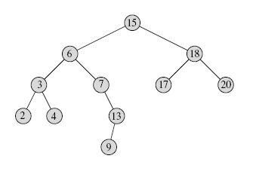
Example
143
The successor of the node with key 15 is the node with key 17, since it is the minimum key in the right subtree of 15.
The node with key 13 has no right subtree, and thus its successor is its lowest ancestor whose left child is also an ancestor. In this case, the node with key 15 is its successor.

Slide 130
Insertion and Deletion
144
The operations of insertion and deletion cause the dynamic set represented by a binary search tree to change.
The data structure must be modified to reflect this change, but in such a way that the binary-search-tree property continues to hold.
As we shall see, modifying the tree to insert a new element is relatively straightforward, but handling deletion is somewhat more intricate.

Slide 131
Insertion
145
To insert a new value v into a binary search tree T , we use the procedure TREE INSERT.
The procedure is passed a node z for which key[z] = v, left[z] = NIL, and right[z] = NIL.
It modifies T and some of the fields of z in such a way that z is inserted into an appropriate position in the tree.

Slide 132
Tree-Insert Procedure
146
TREE-INSERT(T, z)
y ← NIL
x ← root[T]
while x ≠ NIL
do y ← x
if key[z] < key[x]
then x ← left[x]
else x ← right[x] 8 p[z] ← y
if y = NIL
then root[T] ← z
else if key[z] < key[y]
then left[y] ← z
else right[y] ← z

Slide 133
How it Works ?
147
The pointer x traces the path, and the pointer y is maintained as the parent of x. After initialization, the while loop in lines 3–7 causes these two pointers to move down the tree, going left or right depending on the comparison of key[z] with key[x], until x is set to NIL.
This NIL occupies the position where we wish to place the input item z. Lines 8–13 set the pointers that cause z to be inserted.

Slide 134
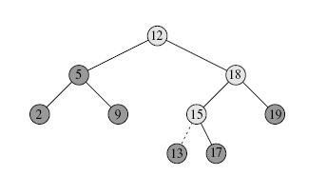
Insert Operation in BST
148
Inserting an item with key 13 into a binary search tree.
Lightly shaded nodes indicate the path from the root down to the position where
the item is inserted.
The dashed line indicates the link in the tree that is added to insert the item.

Slide 135
Deletion in BST
149
The procedure for deleting a given node z from a binary search tree takes as an argument a pointer to z. The procedure considers the three cases:
If z has no children, we modify its parent p[z] to replace z with NIL as its child.
If the node has only a single child, we “splice out” z by making a new link
between its child and its parent.
Finally, if the node has two children, we splice out z’s successor y, which has no left child and replace z’s key and satellite data with y’s key and satellite data.

Slide 136
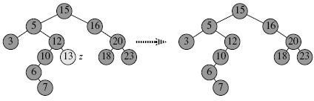
Tree Deletion - Case 1
150

Slide 137
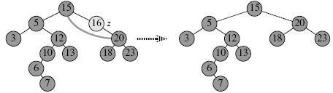
Tree Deletion - Case 2
151

Slide 138
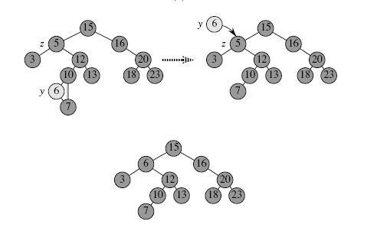
Tree Deletion - Case 3
152

Slide 139
Threaded Binary Tree
Introduction
A binary tree can be represented using array representation or linked list representation. When a binary tree is represented using linked list representation, the reference part of the node which doesn't have a child is filled with NULL pointer. In any binary tree linked list representation, there are more number of NULL pointers than actual pointers. Generally, in any binary tree linked list representation, if there are 2N number of reference fields, then N+1 number of reference fields are filled with NULL ( N+1 are NULL out of 2N ).
This NULL pointer does not play any role except indicating that there is no link (no child). A. J. Perlis and C. Thornton have proposed new binary tree called "Threaded Binary Tree", which makes use of NULL pointers to improve its traversal process. In threaded binary tree, NULL pointers are replaced by references of other nodes in the tree. These extra references are called as threads.

Slide 140
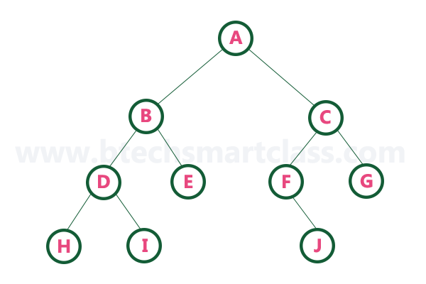
TBT Contd…
Threaded Binary Tree is also a binary tree in which all left child pointers that are NULL (in Linked list representation) points to its in-order predecessor, and all right child pointers that are NULL (in Linked list representation) points to its in-order successor.
If there is no in-order predecessor or in-order successor, then it points to the root node.
Consider the following binary tree...

Slide 141
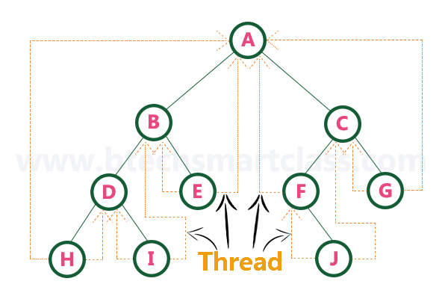
TBT Contd…
In-order traversal of above binary tree: H - D - I - B - E - A - F - J - C - G
When we represent the above binary tree using linked list representation, nodes H, I, E, F, J and G left child pointers are NULL. This NULL is replaced by address of its in-order predecessor respectively, but here the node H does not have its in-order predecessor, so it points to the root node A. And nodes H, I, E, J and G right child pointers are NULL. This NULL pointers are replaced by address of its in-order successor respectively, but here the node G does not have its in-order successor, so it points to the root node A.

Slide 142
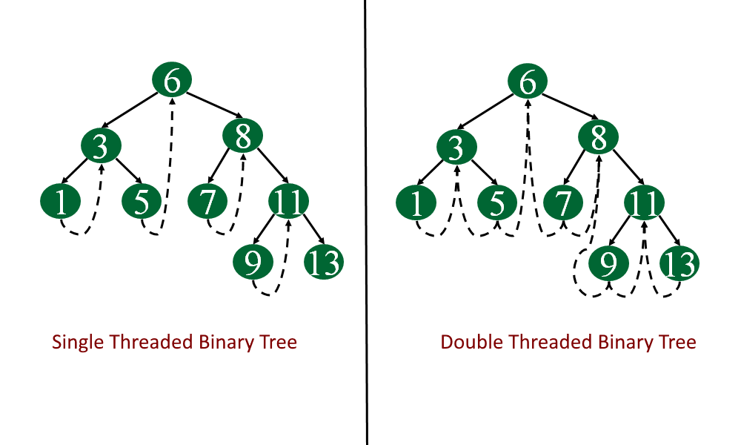
Types of TBT
There are two types of threaded binary trees:
Single Threaded: each node is threaded towards either the in-order predecessor or successor (left orright) means all right null pointers will point to inorder successor OR all left null pointers will point to inorder predecessor.
Double threaded: each node is threaded towards both the in-order predecessor and successor (left andright) means all right null pointers will point to inorder successor AND all left null pointers will point to inorder predecessor.

Slide 143
TBT Node Implementation
Defining the TBT Node
struct TBTNode
{
struct TBTNode *Lchild, *Rchild;
int data;
boolean Lbit;
boolean Rbit;
};
Lbit
Lchild
Data
Rchild
Rbit
TBT Node Structure

Slide 144
Traversing a Threaded Binary Tree
For every node, visit the left sub-tree first, provided if one exists and has not been visited earlier. Then the node (root) itself is followed by visiting its right sub-tree (if one exists). In case there is no right sub-tree, check for the threaded link and make the threaded node the current node in consideration.
The algorithm for in-order traversal of a threaded binary tree is
Step 1: check if the current node has a left child that has not been visited. If a left child exists that has not been visited, go to Step 2, else go to Step 3.
Step 2: add the left child in the list of visited nodes. Make it as the current node and then go to Step 6.
Step 3: If the current node has a right child, go to Step 4 else go to Step 5.
Step 4: Make that right child as current node and go to Step 6.
Step 5: print the node and if there is a threaded node make it the current node.
Step 6: If all the nodes have visited then END else go to Step 1.

Slide 145
TBT inorder traversal
153
Inorder Taversal using Threads Following is C++ code for inorder traversal in a threaded binary tree.
struct Node* leftMost(struct Node *n)
{
if (n == NULL)
return NULL;
while (n->left != NULL)
n = n->left;
return n;
}
void inOrder(struct Node *root)
{
struct Node *cur = leftmost(root);
while (cur != NULL)
{
cout<<cur->data;
// If this node is a thread node, then go to
// inorder successor
if (cur->rightThread)
cur = cur->right;
else // Else go to the leftmost child in right subtree
cur = leftmost(cur->right);
}
}

Slide 146
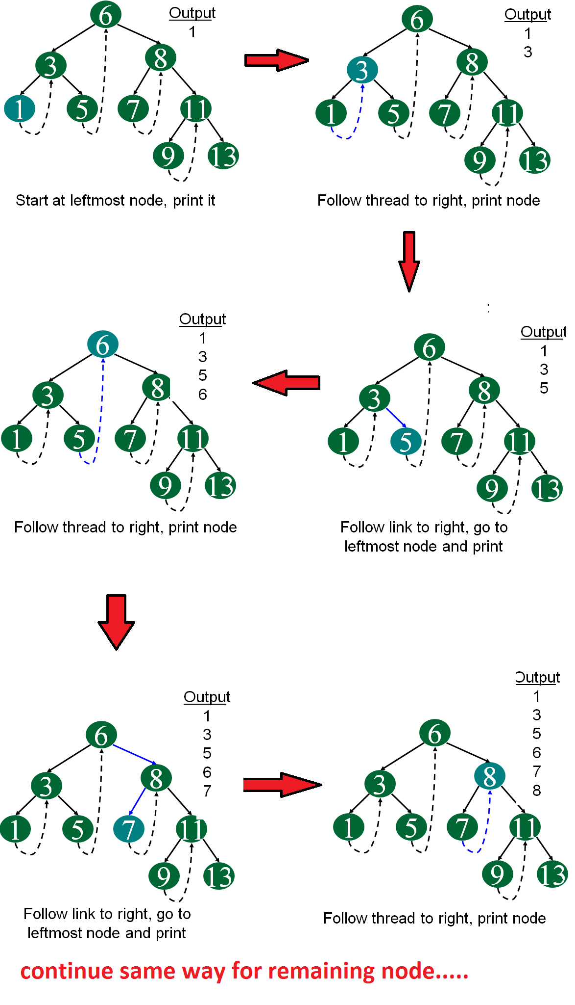
In our Example

Slide 147
TBT Advantages
Advantages of Threaded Binary Tree
It enables linear traversal of elements in the tree.
Linear traversal eliminates the use of stacks which in turn consume a lot of memory space and computer time.
It enables to find the parent of a given element without explicit use of parent pointers.
Since nodes contain pointers to in-order predecessor and successor, the threaded tree enables forward and backward traversal of the nodes as given by in-order fashion.

Slide 148
Insertion in TBT
Insertion in Binary threaded tree is similar to insertion in binary tree but we will have to adjust the threads after insertion of each element.
Defining the TBT Node
struct TBTNode
{
struct TBTNode *Lchild, *Rchild;
int data;
boolean Lbit;
boolean Rbit;
};
Lbit
Lchild
Data
Rchild
Rbit
TBT Node Structure

Slide 149
Insertion in TBT
There can be three cases during insertion:
Case 1: Insertion in empty tree Both left and right pointers of tmp will be set to NULL and new node becomes the root.
root = tmp;
tmp -> left = NULL;
tmp -> right = NULL;
Case 2: When new node inserted as the left child After inserting the node at its proper place we have to make its left and right threads points to inorder predecessor and successor respectively.
The node which was inorder successor. So the left and right threads of the new node will be-
tmp -> left = par ->left;
tmp -> right = par;
Before insertion, the left pointer of parent was a thread, but after insertion it will be a link pointing to the new node.
par -> lthread = false;
par -> left = temp;

Slide 150
Insertion in TBT

Slide 151
Insertion in TBT
Predecessor of 14 becomes the predecessor of 13, so left thread of 13 points to 10. Successor of 13 is 14, so right thread of 13 points to left child which is 13. Left pointer of 14 is not a thread now, it points to left child which is 13.

Slide 152
Insertion in TBT
Case 3: When new node is inserted as the right child
The parent of tmp is its inorder predecessor. The node which was inorder successor of the parent is now the inorder successor of this node tmp.
So the left and right threads of the new node will be-
tmp -> left = par;
tmp -> right = par -> right;
Before insertion, the right pointer of parent was a thread, but after insertion it will be a link pointing to the new node.
par -> rthread = false;
par -> right = tmp;

Slide 153
Insertion in TBT

Slide 154
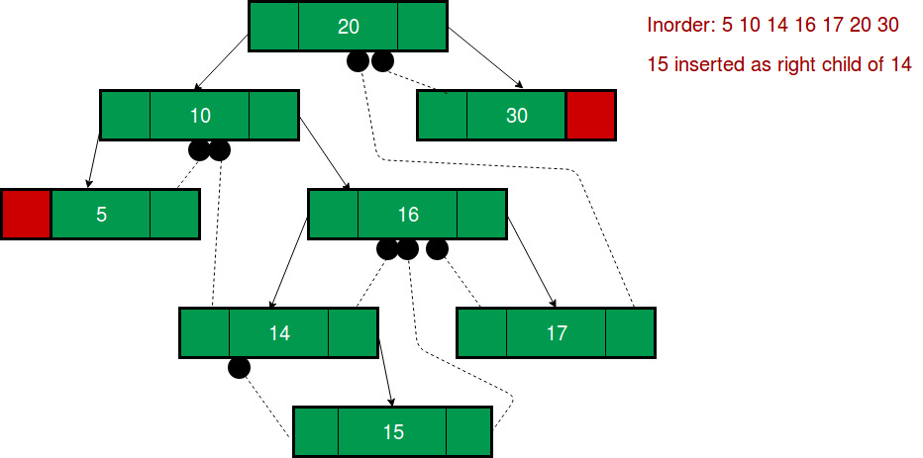
Insertion in TBT
Successor of 14 becomes the successor of 15, so right thread of 15 points to 16 Predecessor of 15 is 14, so left thread of 15 points to 14. Right pointer of 14 is not a thread now, it points to right child which is 15.

Slide 155
Deletion in TBT

Slide 156
Huffman’s Tree
Huffman coding is an entropy encoding algorithm developed by David A. Huffman that is widely used as a lossless data compression technique. The Huffman coding algorithm uses a variable- length code table to encode a source character where the variable-length code table is derived on the basis of the estimated probability of occurrence of the source character.
The key idea behind Huffman algorithm is that it encodes the most common characters using shorter strings of bits than those used for less common source characters.
The algorithm works by creating a binary tree of nodes that are stored in an array. A node can
be either a leaf node or an internal node. Initially, all the nodes in the tree are at the leaf level and store the source character and its frequency of occurrence (also known as weight).

Slide 157
Huffman’s Tree
The running time of the algorithm depends on the length of the paths in the tree. So, before going into further details of Huffman coding, let us first learn how to calculate the length of the paths in the tree.
The external path length of a binary tree is defined as the sum of all path lengths summed over each path from the root to an external node. The internal path length is also defined in the same manner.
The internal path length of a binary tree is defined as the sum of all path lengths summed over each path from the root to an internal node.
The internal path length, L1 = 0 + 1 + 2 + 1 + 2 + 3 + 3 = 12
The external path length, L2= 2 + 3 + 3 + 2 + 4 + 4 + 4 + 4 = 26
Note that, L + 2 * n = 12 + 2 * 7 = 12 + 14 = 26 = L E
Thus, L + 2n = L , where n is the number of internal nodes. Now if the tree has n external nodes and each external node is assigned a weight, then the weighted path length P is defined as the sum of the weighted path lengths.
Therefore, P = W L + W2L2+ …. + WnLn
where W and L are the weight and path length of an external node N .

Slide 158
Huffman Encoding
Encode a message composed of a string of characters
Codes used by computer systems
ASCII
uses 8 bits per character
can encode 256 characters
Unicode
16 bits per character
can encode 65536 characters
includes all characters encoded by ASCII
ASCII and Unicode are fixed-length codes
all characters represented by same number of bits

Slide 159
Problems with Fixed-length codes
Suppose that we want to encode a message constructed from the symbols A, B, C, D, and E using a fixed-length code
How many bits are required to encode each symbol?
at least 3 bits are required
2 bits are not enough (can only encode four symbols)
How many bits are required to encode the message DEAACAAAAABA?
there are twelve symbols, each requires 3 bits
12*3 = 36 bits are required
Wasted space
Unicode uses twice as much space as ASCII
inefficient for plain-text messages containing only ASCII characters
Same number of bits used to represent all characters
‘a’ and ‘e’ occur more frequently than ‘q’ and ‘z’

Slide 160
Better Solution
Potential solution: use variable-length code
variable number of bits to represent characters when frequency of occurrence is known short codes for characters that occur frequently.
The advantage of variable-length codes over fixed-length is short codes can be given to characters that occur frequently on average, the length of the encoded message is less than fixed-length encoding
Potential problem: how do we know where one character ends and another begins?
not a problem if number of bits is fixed!
A = 00
B = 01
C = 10
D = 11
0010110111001111111111
A C D B A D D D D D

Slide 161
Prefix property
A code has the prefix property if no character code is the prefix (start of the code) for another character
Example:
000 is not a prefix of 11, 01, 001, or 10
11 is not a prefix of 000, 01, 001, or 10 …
Symbol | Code
P | 000
Q | 11
R | 01
S | 001
T | 10
01001101100010
R S T Q P T

Slide 162
Code without prefix property
The following code does not have prefix property
The pattern 1110 can be decoded as QQQP, QTP, QQS, or TS
Symbol | Code
P | 0
Q | 1
R | 01
S | 10
T | 11

Slide 163
Design a variable-length prefix-free code such that the message DEAACAAAAABA can be encoded using 22 bits
Possible solution:
A occurs eight times while B, C, D, and E each occur once
represent A with a one bit code, say 0
remaining codes cannot start with 0
represent B with the two bit code 10
remaining codes cannot start with 0 or 10
represent C with 110
represent D with 1110
represent E with 11110
DEAACAAAAABA
Symbol | Code
A | 0
B | 10
C | 110
D | 1110
E | 11110
1110111100011000000100
22 bits

Slide 164
Another possible code
DEAACAAAAABA
Symbol | Code
A | 0
B | 100
C | 101
D | 1101
E | 1111
1101111100101000001000
22 bits

Slide 165
DEAACAAAAABA
Symbol | Code
A | 0
B | 100
C | 101
D | 110
E | 111
11011100101000001000
20 bits

Slide 166
What code to use?
Question: Is there a variable-length code that makes the most efficient use of space?
Answer: Yes!
Binary tree
each leaf contains symbol (character)
label edge from node to left child with 0
label edge from node to right child with 1
Code for any symbol obtained by following path from root to the leaf containing symbol
Code has prefix property
leaf node cannot appear on path to another leaf
note: fixed-length codes are represented by a complete Huffman tree and clearly have the prefix property

Slide 167
Building a Huffman Tree
Find frequencies of each symbol occurring in message
Begin with a forest of single node trees
each contain symbol and its frequency
Do recursively
select two trees with smallest frequency at the root
produce a new binary tree with the selected trees as children and store the sum of their frequencies in the root
Recursion ends when there is one tree
this is the Huffman coding tree

Slide 168
In our Example
Build the Huffman coding tree for the message
This is his message
Character frequencies
Begin with forest of single trees
A | G | M | T | E | H | I | J | S
1 | 1 | 1 | 1 | 2 | 2 | 3 | 3 | 5
1
1
1
1
2
2
3
3
5
A
G
M
T
E
H
I
J
S

Slide 169
Step 1
2
1
1
1
1
2
2
3
3
5
A
G
M
T
E
H
I
J
S

Slide 170
Step 2
2
2
1
1
1
1
2
2
3
3
5
A
G
M
T
E
H
I
J
S

Slide 171
Step 3
2
4
2
1
1
1
1
2
2
3
3
5
A
G
M
T
E
H
I
J
S

Slide 172
Step 4
4
2
4
2
1
1
1
1
2
2
3
3
5
A
G
M
T
E
H
I
J
S

Slide 173
Step 5
4
2
4
6
2
1
1
1
1
2
2
3
3
5
A
G
M
T
E
H
I
J
S

Slide 174
Step 6
8
4
4
2
2
2
6
2
E
H
1
1
1
1
3
3
5
A
G
M
T
I
J
S

Slide 175
Step 7
8
11
4
4
6
5
S
2
2
2
3
3
2
E
H
I
J
1
1
1
1
A
G
M
T

Slide 176
Step 8
19
8
11
4
4
6
5
S
2
2
2
3
3
2
E
H
I
J
1
1
1
1
A
G
M
T

Slide 177
Labeled Edges
19
0
1
8
11
0
1
0
1
4
4
6
5
0
1
1
S
0
1
0
2
2
2
3
3
2
0
1
0
1
E
H
I
J
1
1
1
1
A
G
M
T

Slide 178
Huffman code & encoded message
Huffman code & encoded message
This is his message
S 11
E 010
H 011
I 100
J 101
A 0000
G 0001
M 0010
T 0011
00110111011110010111100011101111000010010111100000001010

Slide 181


Queries and Discussions

